Slide 1
Discovering Patterns in Breast Cancer Diagnosis
Prepared by:
Bryanna Williams, Biniam Abebe, Guttikonda Bharat, and Maybel Hernandez

Slide 2

Introduction:

Slide 3

The Introduction
Analyzing Breast Cancer Wisconsin (Diagnostic) Data Set from the UC Irvine Machine Learning Repository
Aim is to determine which methods accurately detects a cancer diagnosis
Findings could contribute to cancer research efforts

Slide 4
The Team
Answer the question, “Why is this research import to us”
Bryanna Williams
Biniam Abebe
Maybel Hernandez
Guttikonda Bharat
Family members of mine have been diagnosed with cancer. Thankfully, they have survived it. This shows me the importance of early and accurate detection.
In my work in health care, finding new ways to find current diagnoses is one of my goals
My mother and father are both cancer survivors thanks in part to early detection and accurate diagnosing of their cancer.
My Grandmother was affected by the cancer Unfortunately she expired in the early it was not detected

Slide 5
Exploring the Data:

Slide 6
Exploring the Data
The dataset consisted of 569 samples and 32 columns of variables
Variables included features such as
Diameter
Symmetry
Smoothness
The data was collected from images of Fine Needle Aspirates

Slide 7
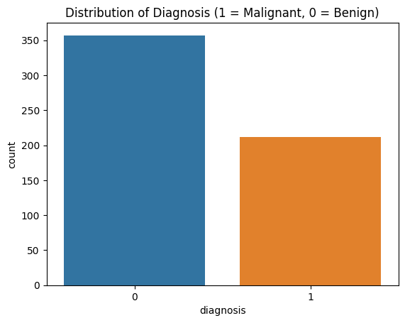
Exploring the Data
This chart is based on 569 cancer diagnostic results where 357 patients had a benign result compared to 212 patients where the results were malignant.

Slide 8
What we Already Know:

Slide 9
What We Already Know
A 2020 study reported over 2.2 million new breast cancer diagnoses
Breast cancer was linked to approx 685,000 deaths that year
Researchers have currently used Decision Trees, KNN, Support Vector Machine to study breast cancer

Slide 10
The Problem/Question:

Slide 11
The problem
How effective is linear regression to predicting accurate diagnosis?

Slide 12

The Methodology:

Slide 13
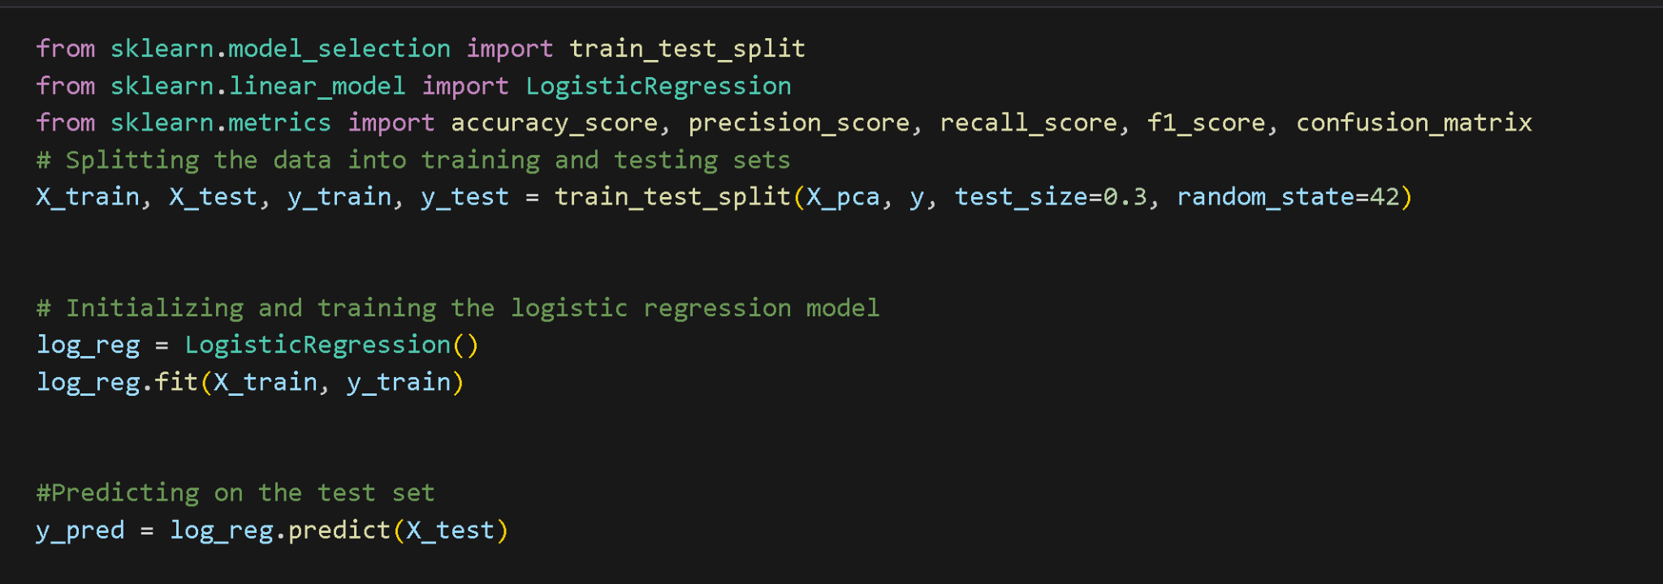
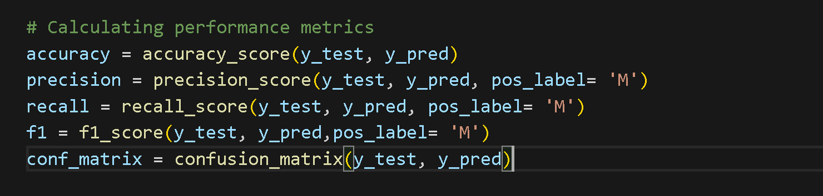
How it works
Notes:
70/30 data split

Slide 14
The Results:

Slide 15
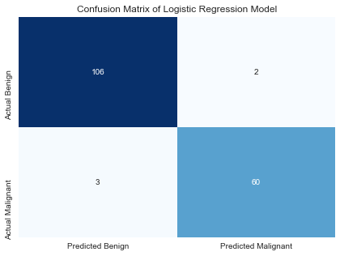
The Results
60 cases were correctly predicted to be malignant True Negative 106 cases were correctly predicted to be benign False Positives
2 cases were incorrectly predicted as malignant,
3 cases were incorrectly predicted as benign. False Negatives Three cases were incorrectly predicted as benign when they were malignant.

Slide 16
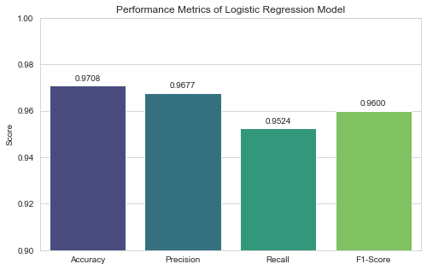
The Results
Accuracy: 0.9708 (97.8%),
Precision: 0.9677 (96.77%),
Recall: 0.9524 (95.24%),
F1-Score: 0.9600 (96.00%).
Based on these metrics, the Logistic Regression Model performs quite well on all key evaluation aspects. It is highly reliable in identifying true malignant cases and maintains low false positive rates while accurately classifying cases.

Slide 17

Why now?
Cancer rates have skyrocketed the past few decades.

Slide 18

The Conclusion
Logistic regression proved to be efficient for differentiation between benign and malignant cases.
The performance metrics such as accuracy, precision, recall, and F1-score showed the reliability of the model.
PCA improved the model’s interpretability by concentration on the critical attributes.
These results have immediate implications for improving early detection and outcomes in breast cancer.
Collaboration across different disciplines is necessary in the improvement of predictive models and the development of precision medicine.

Slide 19
References
Wolberg,William, Mangasarian,Olvi, Street,Nick, and Street,W.. (1995). Breast Cancer Wisconsin (Diagnostic). UCI Machine Learning Repository. https://doi.org/10.24432/C5DW2B.
Fatima, N., Liu, L., Hong, S., & Ahmed, H. (2020). Prediction of Breast Cancer, Comparative Review of Machine Learning Techniques, and Their Analysis. IEEE Access, 8, 150360–150376. https://doi.org/10.1109/access.2020.3016715
Naji, M. A., Filali, S. E., Aarika, K., Benlahmar, E. H., Abdelouhahid, R. A., & Debauche, O. (2021). Machine Learning Algorithms For Breast Cancer Prediction And Diagnosis. Procedia Computer Science, 191, 487–492. https://doi.org/10.1016/j.procs.2021.07.062

